Slide 1
Genetic Algorithm Optimization for Selecting the Best Architecture of a Multi-Layer Perceptron Neural Network.
A Credit Scoring Case
Alejandro Correa, Banco Colpatria
Andrés González, Banco Colpatria
Camilo Ladino, Banco Colpatria
Camilo Ladino, Banco Colpatria
Notes:
Copyright © 2010, SAS Institute Inc. All rights reserved.

Slide 2
Contents
Introduction.
Data description.
General concepts.
Modeling.
Results.
Conclusion.

Slide 3
Introduction
Mitigate impact of credit risk.
Scorecards.
Multi-Layer Perceptron (MLP) neural network.
Architectural issues.
Optimization by Genetic Algorithms.

Slide 4
The problem
Increase predictive power.
Complexity in model development.
Time and effort.

Slide 5
The solution
Multi-Layer perceptron (MLP) Neural Network.
Optimize the architecture.
Genetic Algorithms (GA).
SAS®

Slide 6
Data Description
120000 active clients from the financial institution.
Seven standardized variables (X1 ... X7).
Maximum correlation is low (0.0176).
Randomly divided into three datasets:
Data | Percentage of the total population
Train | 40%
Validation | 30%
Test | 30%
Total | 100%

Slide 7
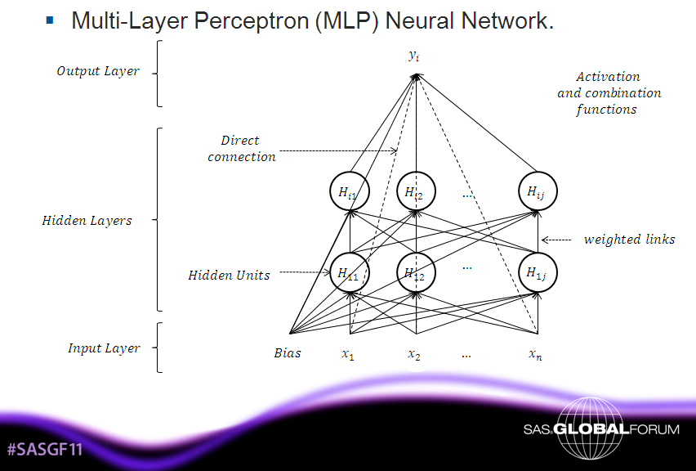
General Concepts
|

Slide 8



















General Concepts
Genetic Algorithm (GA).
Elite Solution
f(x)
Define objective function, input variables
85
Generate initial population
Decode chromosomes
73
1
Evaluate each chromosome in the objective function
Variable 1
00 = 1
01 = 2
10 = 3
11 = 4
Variable n
0 = No
1 = Yes
42
1
n
Select parents
39
0
Mating
Mutation
Convergence check
Stop

Slide 9
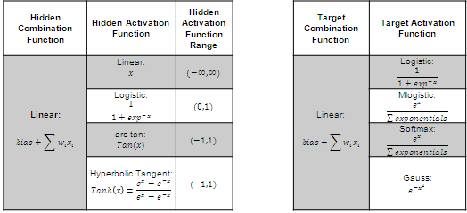
Modeling
Multi-Layer Perceptron (MLP) Neural Network.
  Activation and Combination Functions.
  Backpropagation algorithm.

Slide 10
Modeling
Genetic Algorithm (GA).
  Objective function: Maximize the ROC curve.
  Chromosome structure:
1
2
3
4
5
6
7
8
9
10
11
12
Hidden Layers
Hidden Units
DC
HL Bias
HL Activation
TL Activation
TL Bias
Hidden Layers
00 = 1
01 = 2
10 = 3
11 = 4
Hidden Units
000 = 1
001 = 2
…
111 = 8
Direct Connection
0 = No
1 = Yes
Hidden Layers Bias
0 = No
1 = Yes
Hidden Layers Activation Function
00 = Logistic
01 = Linear
10 = Act Tan
11 = Tan H
Target Layer Activation Function
00 = Logistic
01 = Mlogistic
10 = Softmax
11 = Gauss
Target Layer Bias
0 = No
1 = Yes
  Total population: 16 chromosomes.
  Mutation: 2% of the genes of the total population.
  Elitism : Best four solutions.
  Convergence criterion: 30 iterations.

Slide 11
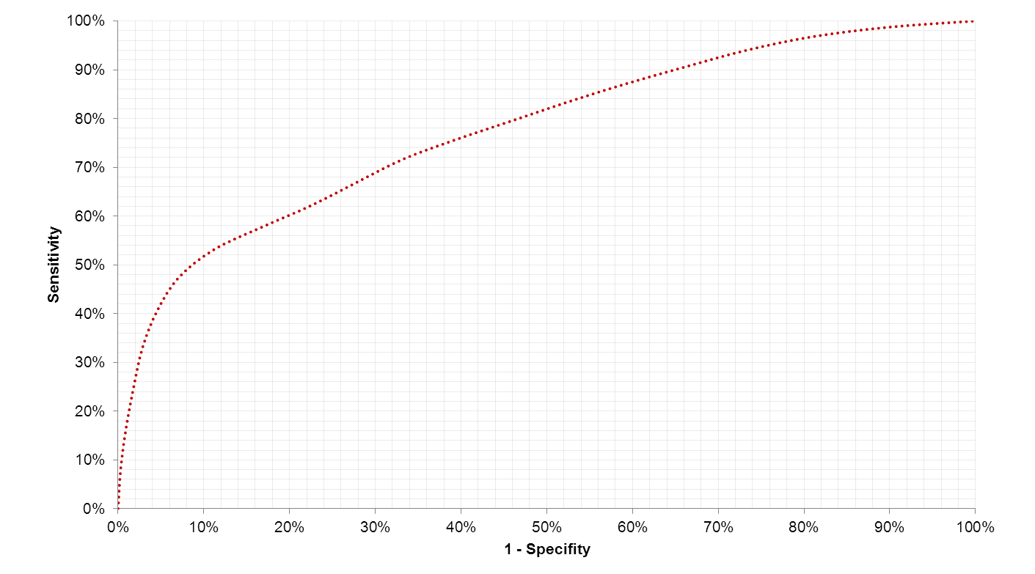
Results
Genetic Algorithm in the MLP neural network.
Logistic Regression: PROC LOGISTIC stepwise.
Default Neural Network: SAS Enterprise MinerTM.
Global Optimum: 4096 possible combinations (2 ^{#Gens}).

Slide 12

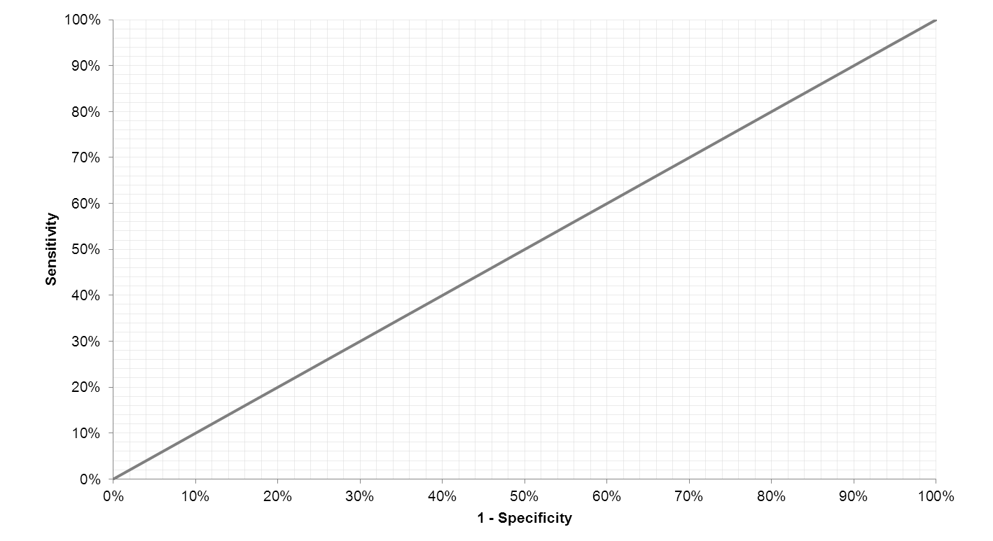
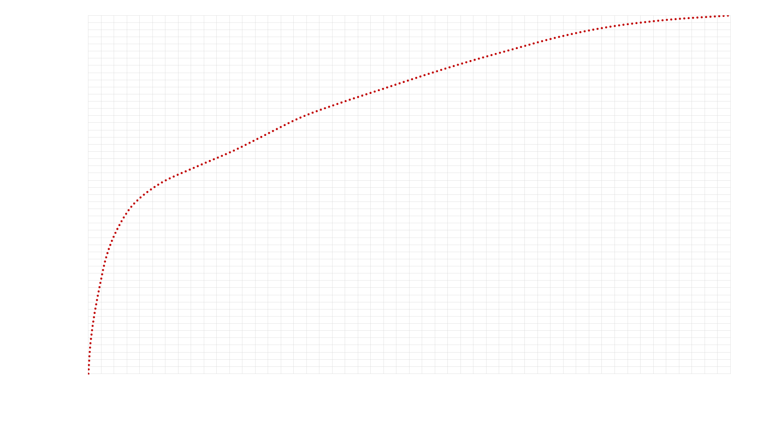
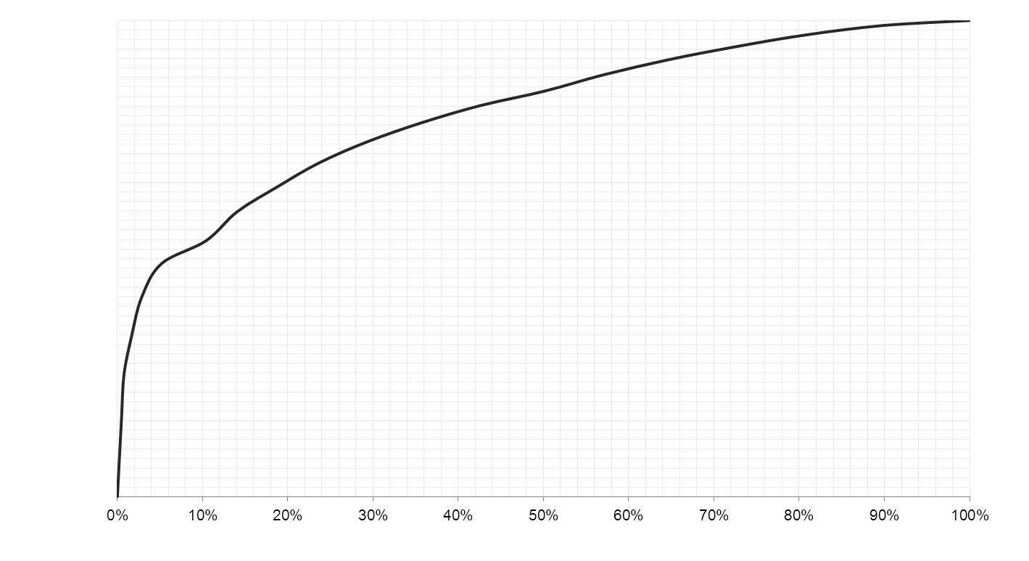
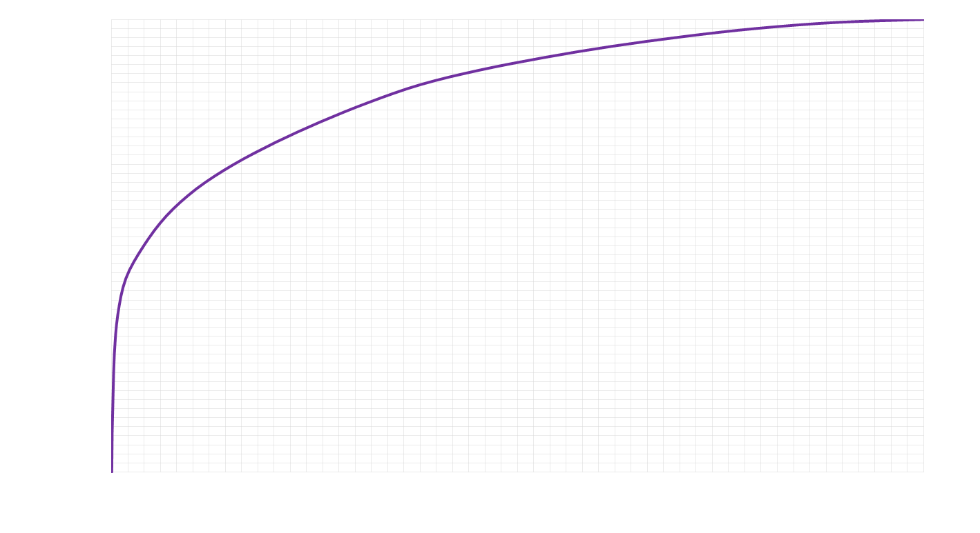
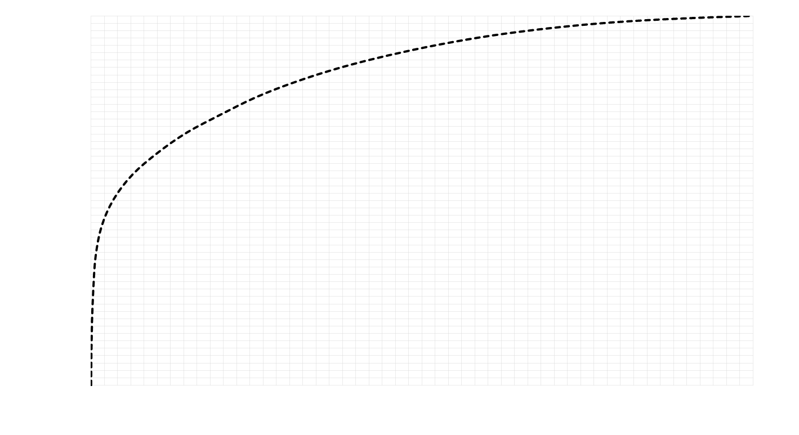
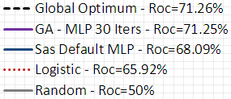
Results
Logistic Regression – ROC = 65.92 %
Global Optimum – ROC = 71.26 %
SAS E. MinerTM Default MLP – ROC = 68.09 %
GA – MLP 30 iters. – ROC = 71.25 %
Notes:
#SASGF11
Copyright © 2010, SAS Institute Inc. All rights reserved.

Slide 13
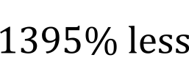
Results
Measures of Comparison
Model | ROC | CPU time (minutes) | Function calls
Logistic Regression | 65.92% | 1 | 1
Default MLP | 68.09% | 2 | 1
GA - MLP 30 iterations | 71.25% | 559 | 274
Global Optimum | 71.26% | 8356 | 4096

Slide 14
Conclusion
Less computational effort.
Time saving.
Approximately equal to the global optimum.
GA outperformed results of logistic regression and MLP with SAS default parameters.
More powerful scorecards
with a better technique
in a reasonable time.

Slide 15
Thank You!

Slide 16
Contact Information
Alejandro Correa
Banco Colpatria – GE Capital
Bogotá, Colombia
(+57) 3208306606
correaal@colpatria.com
Andrés González
Banco Colpatria – GE Capital
Bogotá, Colombia
(+57) 3103595239
gonzalean@colpatria.com
Camilo Ladino
Banco Colpatria – GE Capital
Bogotá, Colombia
(+57) 3185865390
ladinoi@colpatria.com

Slide 17
opening should be concise and your purpose clearly stated
Use a closing slide to summarize your main points.
Use a mixture of slides that show text, flow charts, and output. Images such as screen captures can be used to show a product’s application in the workplace.
Divide ideas into groups of 3 to 5. People can more easily grasp information in small segments.
Keep the graphics minimal and the colors muted for readability.
• Limit the text in your visuals to the main concepts.
Conclude your presentation by repeating your opening theme and main ideas.
When your presentation is finished, thank your audience for their attention and ask if there are any questions (while you are still at the podium).
Advice. . .I try to do an outline, maybe not written but think about how I will organize the presentation. The first slide in the presentation is the title, second slide is the “outline” so presentation attendees know what to expect. The outline is major points, Introduction, Background, Data, Methods, Results, Conclusion. I try to limit to 3-5 major points. Then if you follow what you’ve presented in your paper, it should be easy to setup the presentation.

